Slide 1
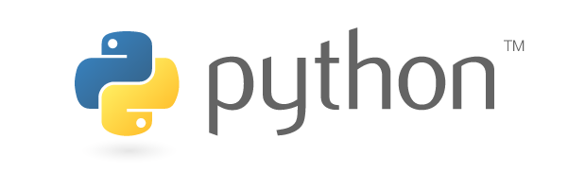
Set up new Python interpreter and ZVPython

Slide 2
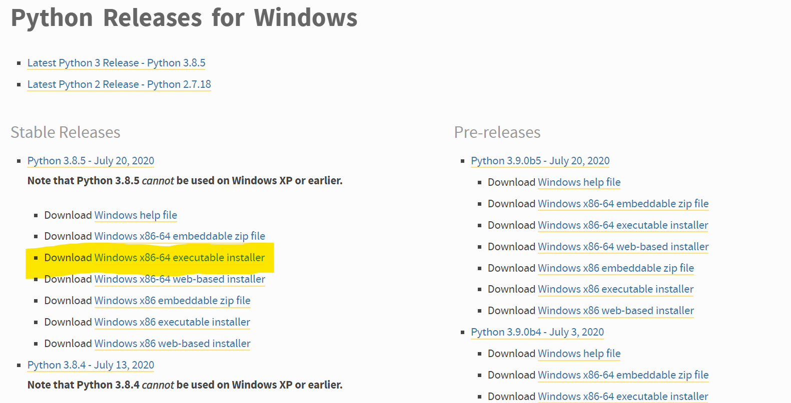
1st step
Download desired Python from https://www.python.org/downloads/windows/
Notice to download the executable distribution as marked

Slide 3
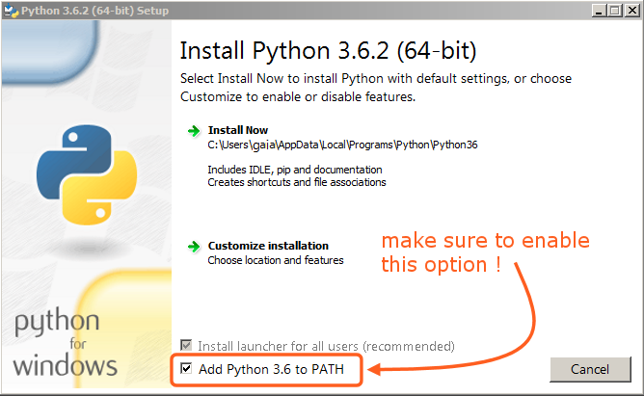
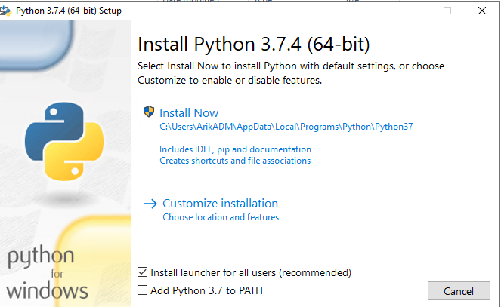
2nd step
Make sure to check those following boxes. Then, click on ‘Customize installation’
Make sure to enable this option too!

Slide 4
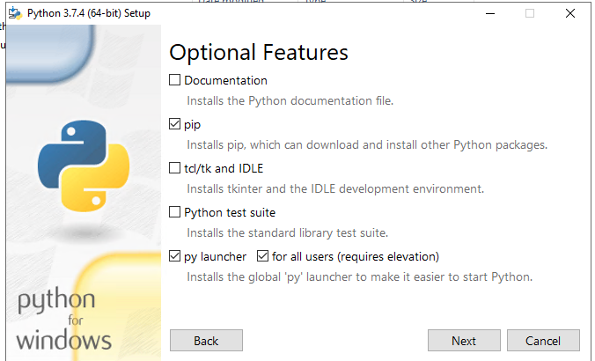
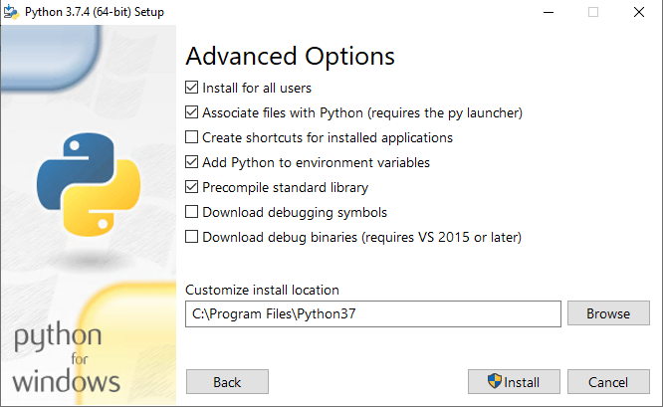
3rd Step
Make sure to check all the following boxes, then, click ‘Install’
Click ‘Next’ to get to the ‘Advanced Options’ screen

Slide 5
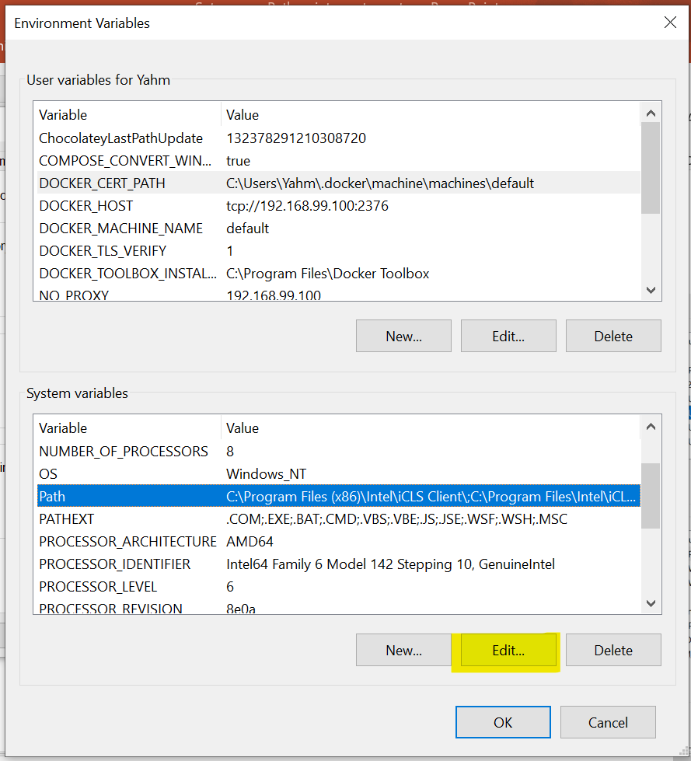
4th step
Enter ‘Environment Variables‘ and click ‘Edit’
at ‘Path’ under ‘System variables’

Slide 6
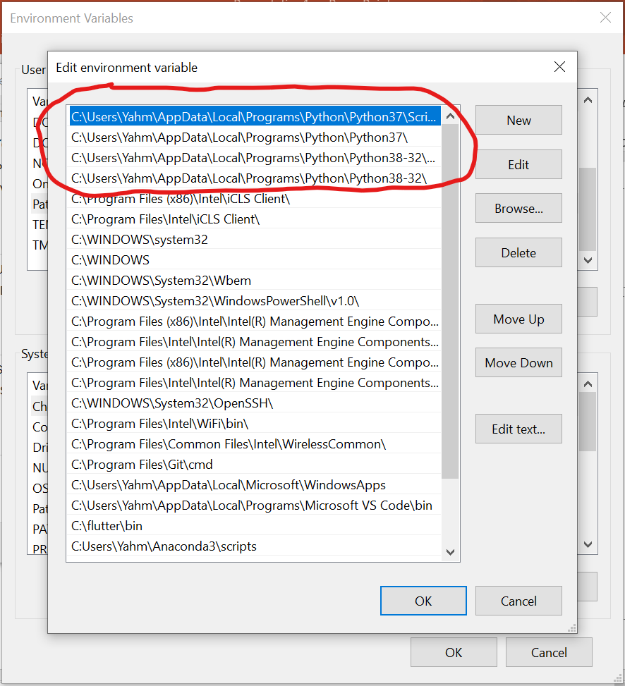
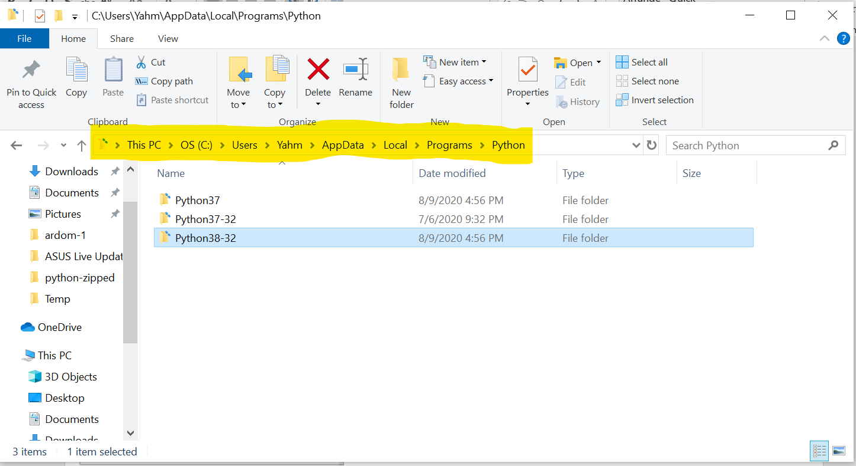
5th step
You will be able to see where Python is installed – open the newly installed Python folder

Slide 7
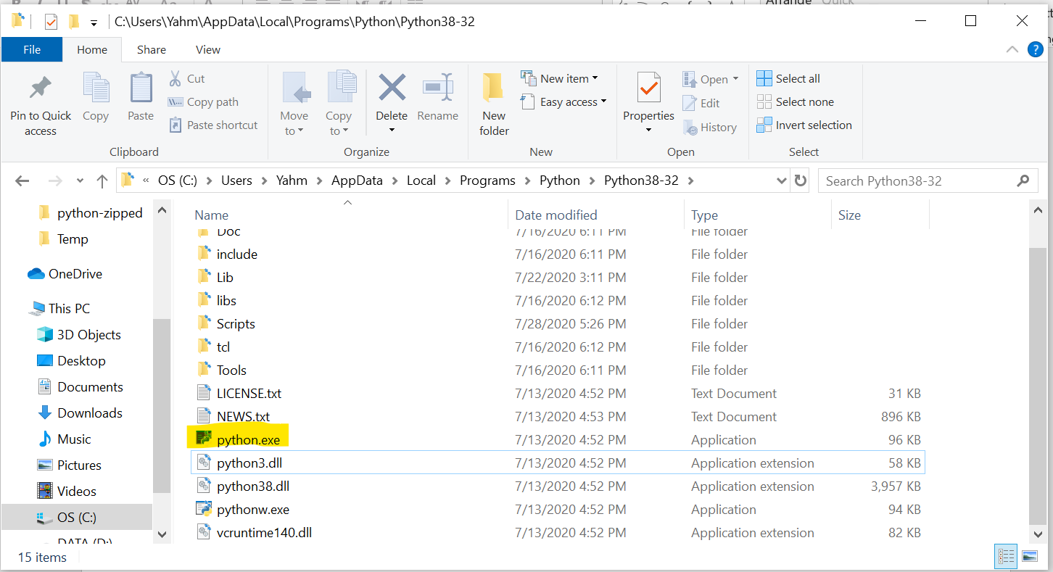
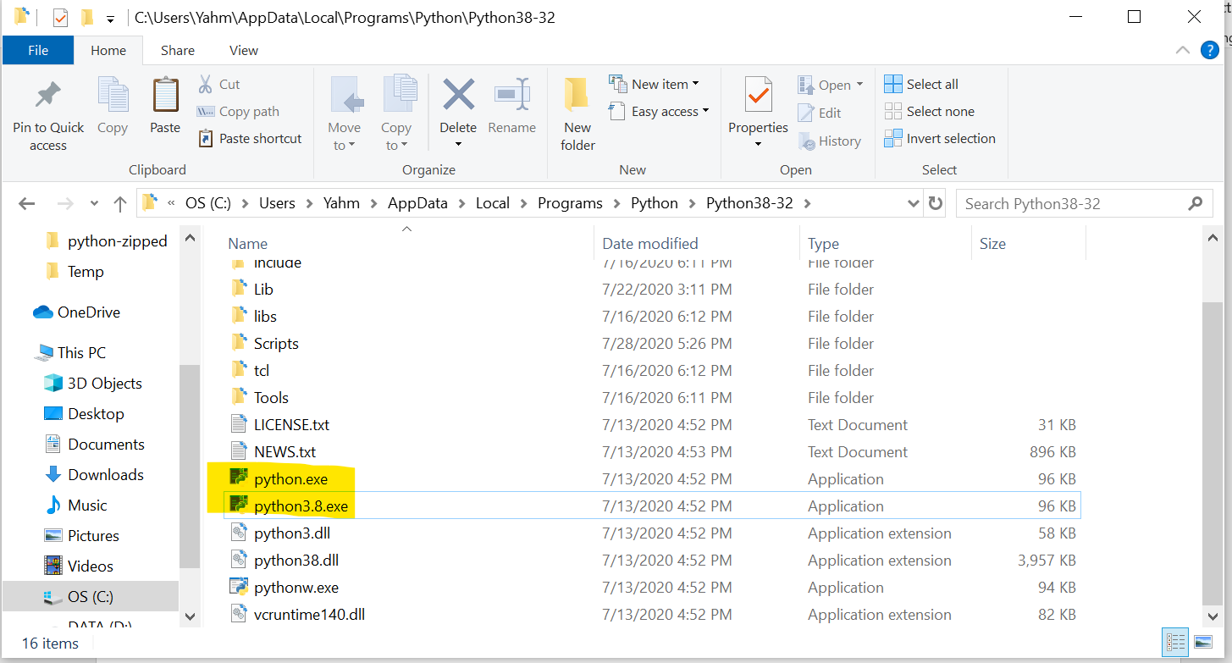
6th step
Duplicate ‘python.exe’ file and rename the new one as you wish, preferably pythonXX.exe (python + version number)

Slide 8
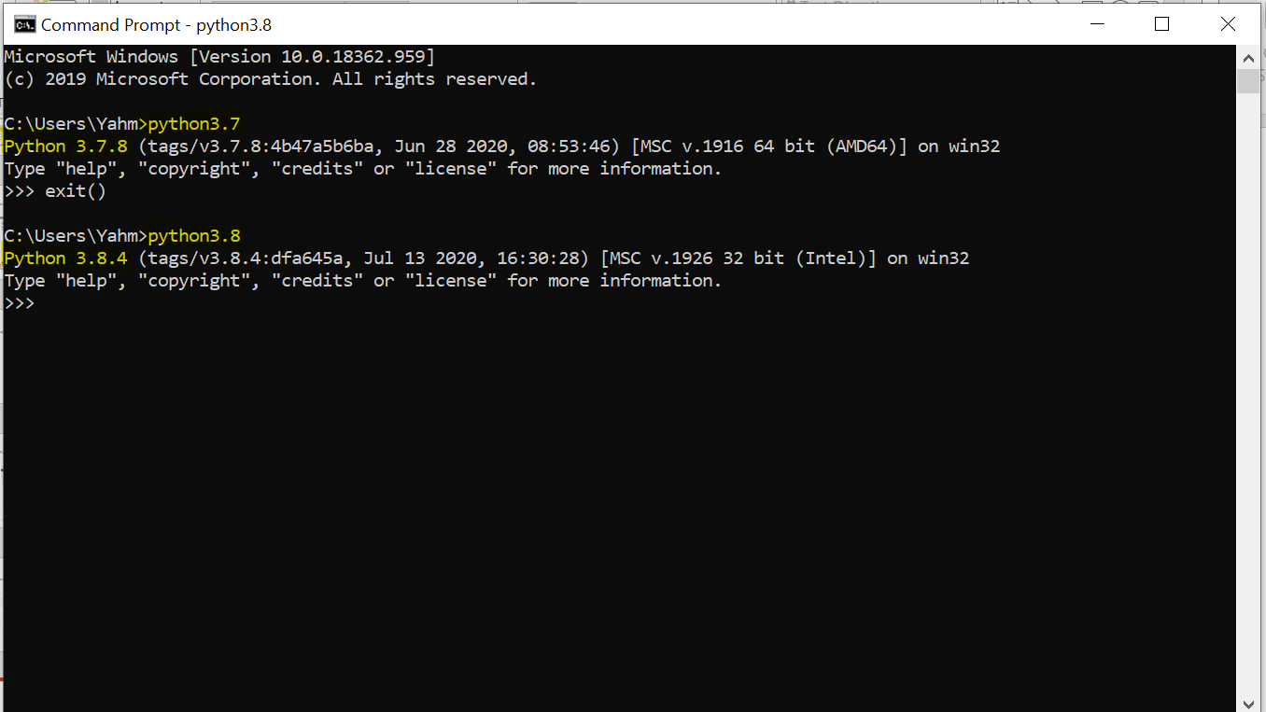
7th step
Access Python with the newly duplicated .exe file name!

Slide 9
Set up ZVPython app
1st step – set up Python interpreter as documented in the beginning of the presentation.
2nd step – Modify the batch template as needed, and add source code and requirements.txt file. Copy all that to the server destination – ‘C\Program files\ZVPython’

Slide 10
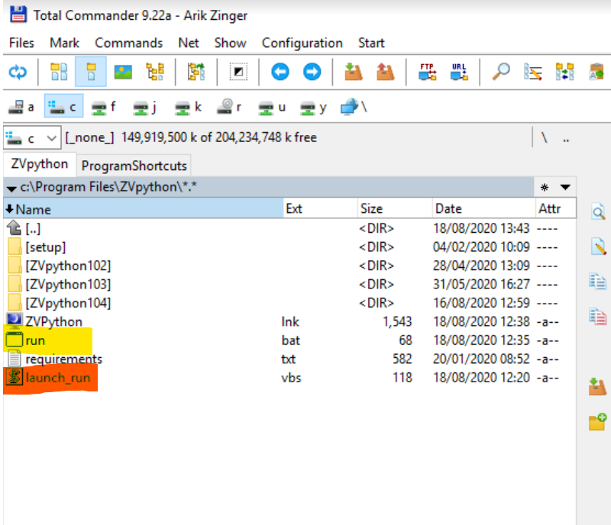
3rd step – Edit the ‘run.bat’ file (from outside the new version directory, marked in yellow) to point to the new version app. Then, lunch it by running the .vbs file marked in red.
The .vbs file is running ‘run.bat’ without cmd, which then runs the .vbs file from inside the desired app-version folder, which then runs the .bat file that executes the app

Slide 11
Upgrade the ZVPython app
1st step - Update source code and requirements.txt file as needed
2nd step - Modify ‘resetup.bat’ template as needed
3rd step - Run ‘resetup.bat’

